Slide 1
Aboyne Hospital 2025
Who and what are we?
What services do we offer?
What are some of our future challenges?

Slide 2
Who / What are we?

Slide 3
Who / What are we?
Community Hospital
Inpatient & Outpatient services
Patients
Staff
Medical Cover

Slide 4
What services do we offer?
Inpatient Services
Acute Illness – investigation & management
Rehabilitation & Discharge Planning
Symptom control
Palliative/End of Life Care
NOT for convalescence or respite

Slide 5
What services do we offer?
Day Case Procedures
Blood Transfusions
IV antibiotics
IV infusions
Venesections

Slide 6
What services do we offer?
Outpatient Services
AAA screening
Diabetic Retinal Screening
Adult Mental Health
Optician
X-ray
Holter Monitor Clinic
Community Child Health (Paeditrician)
Minor Surgery
Baby Immunisations
Secondary Care Blood Hub
Cardiology
Medicine for the Elderly
Dietician
Oedema Clinic
Adult Audiology
Newborn Hearing Checks
Antenatal
Bone Density Scanning

Slide 7
Future challenges?
Staffing
Workload
Funding
“Politics”
Support

Slide 8
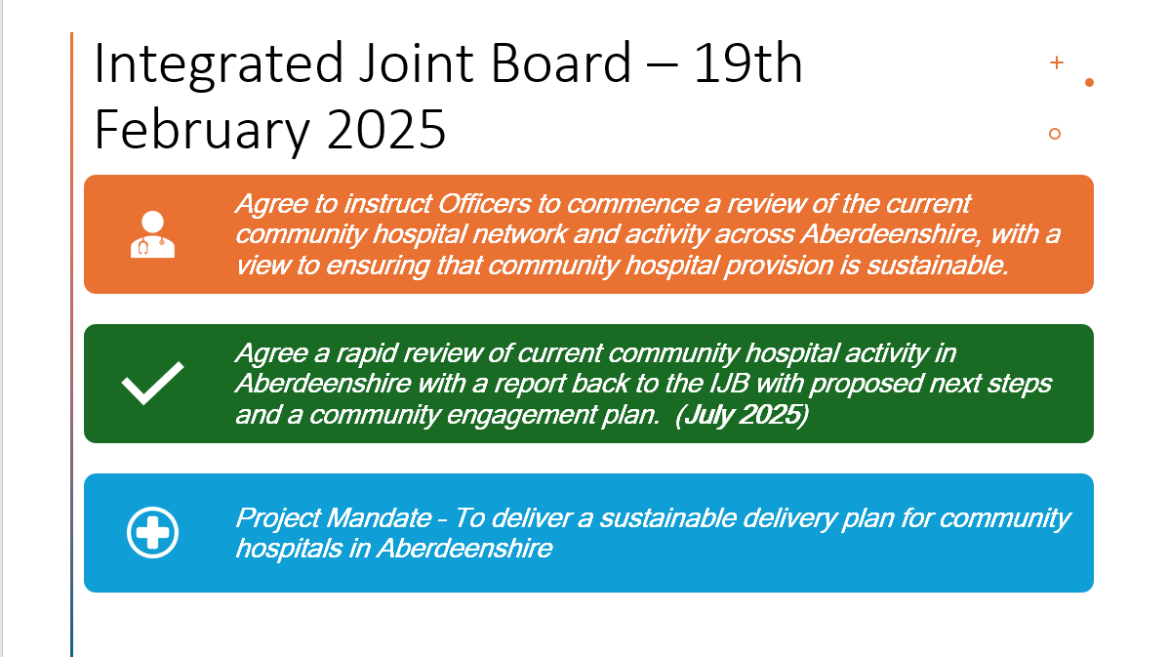
Community Hospital Review

Slide 9
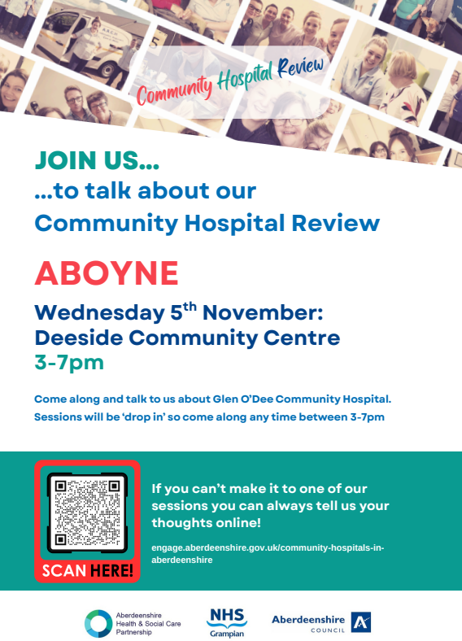
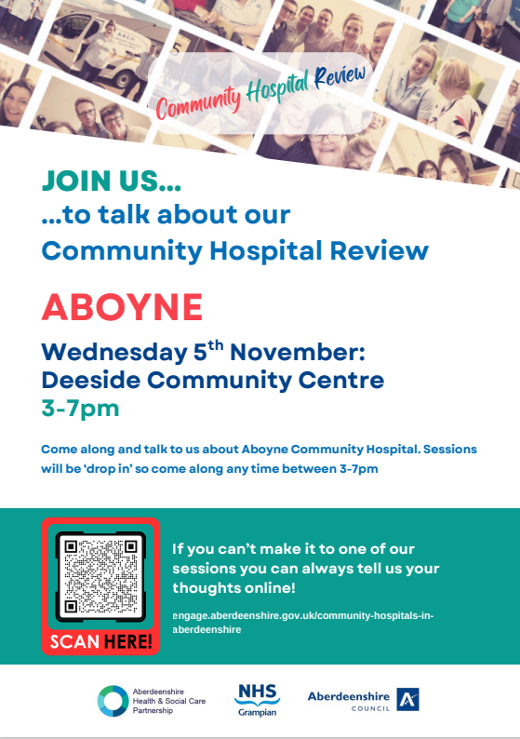
Community Hospital Review
What can you do?

